Slide 1
MARITIME SKILLS – very active members in:
KS2 – Age 7 -11
Target STEM skills
Talks in schools; STEM event at the port
KS3 – Age 11-14
Target careers
Talks in schools and larger career fairs; careers event at port
KS4 – Age 14-16
Target placements
Supporting short placements where there is maritime interest
Further Education - College
Higher Education - University
Professional CPD - Educators
Projects developed with colleges
Target T-level placements and support aligned courses
Target Maritime courses
Target teachers and careers advisors
Engineering and maritime course port visits; talks; longer placements; dissertation projects
Create school ambassadors through Maritime Mondays and talks
Maritime professional networks
Share best practice, network
Introduce career shifters to ports and maritime, provide career pathways
WORKING WITH MARITIME PARTNERS NOW TO INCREASE FUTURE SKILLS PROVISION
FOCUS:
Increase awareness of industry
Portsmouth schools
Disadvantaged students
Support maritime interested students
Level playing field to increase diversity
MAKE RESIDENTS AWARE & PROUD
ASK:
Increase opportunity to use apprenticeship levy on short courses
Assist with financial support to industry bodies for industry wide courses
Assist with benchmarking seafarer skills against land based skills
Support businesses with releasing staff to tutor, undertake careers outreach
Support businesses who take T-Level and Apprentices

Slide 2
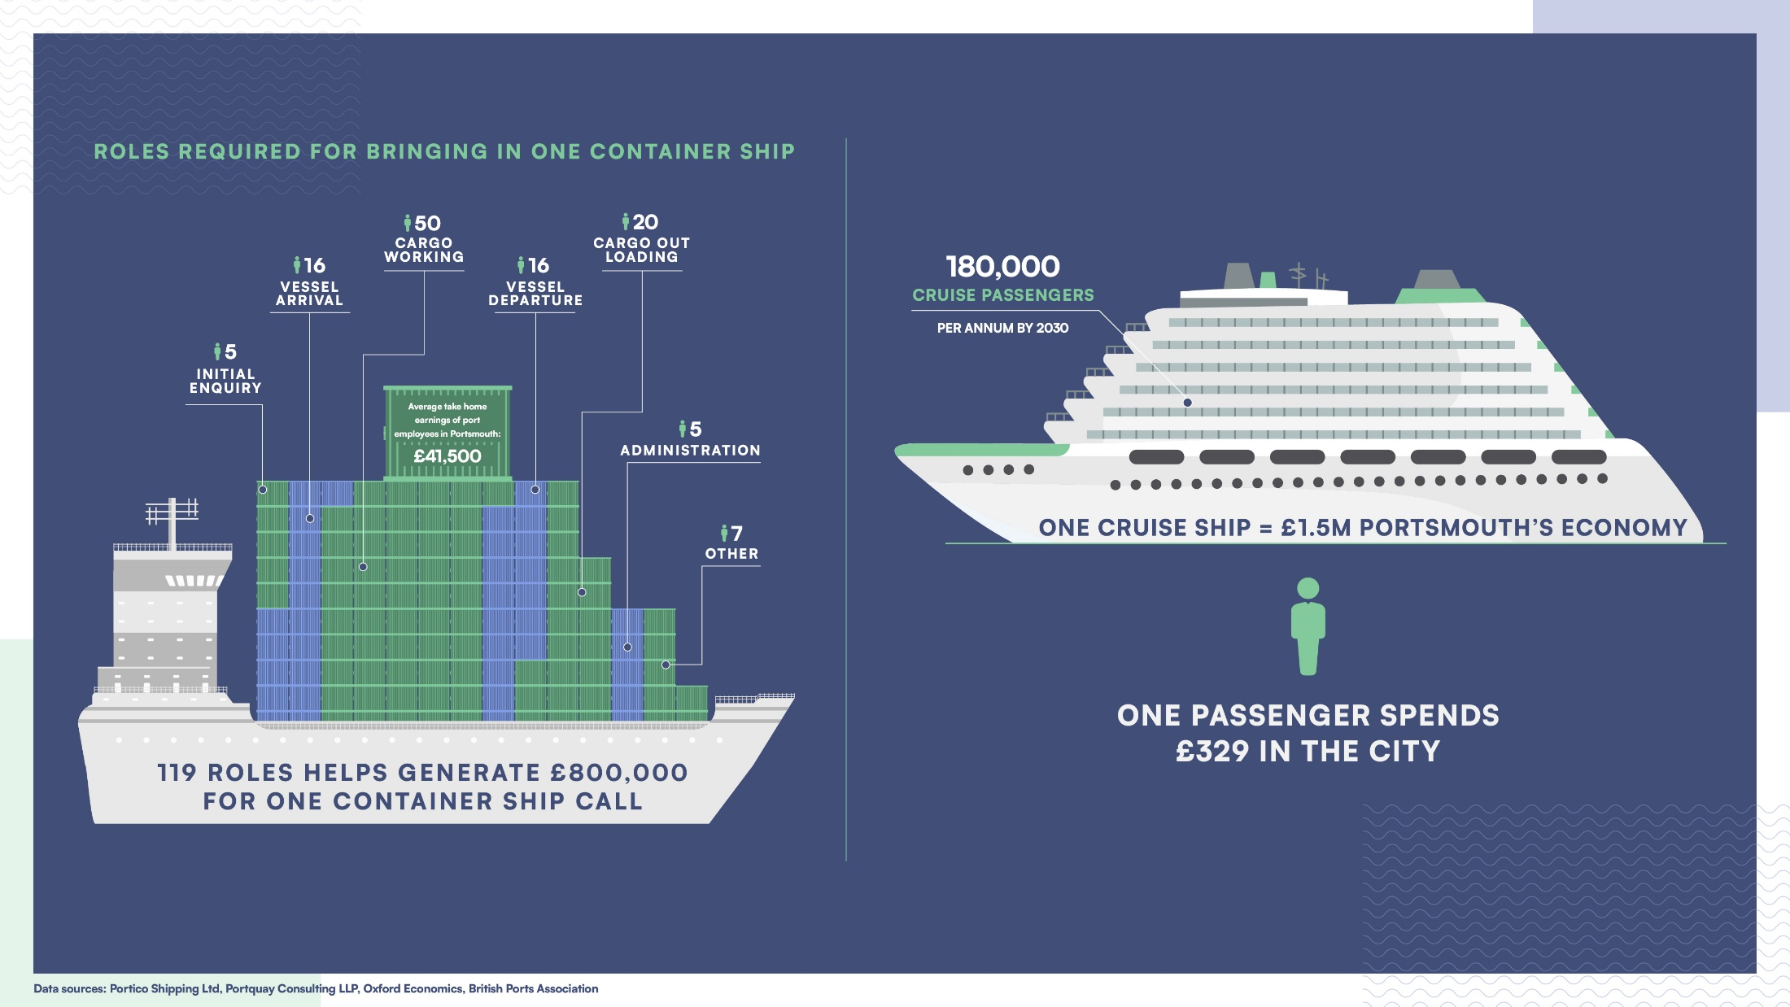

Slide 3
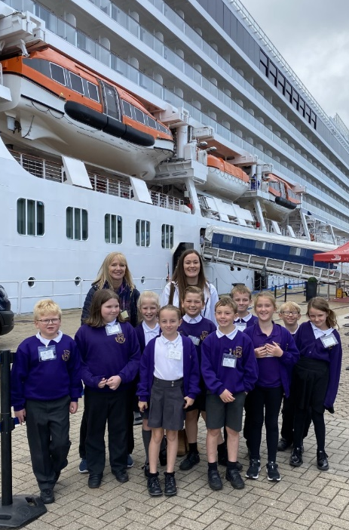
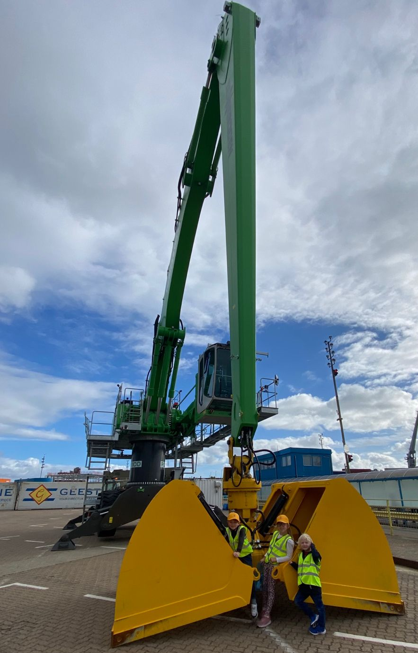
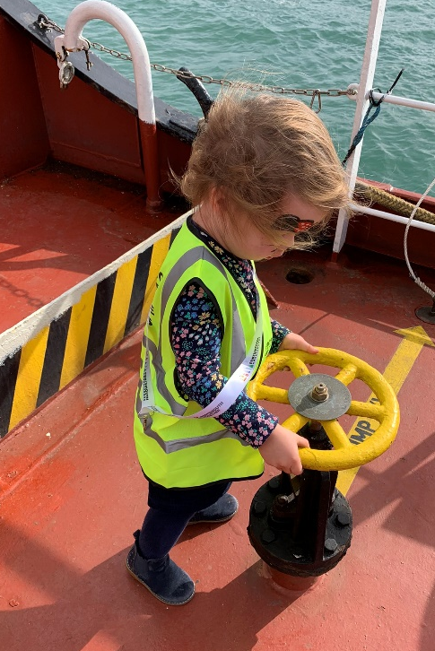
Looking forward
Sustainability includes plans for the future workforce
Includes working with our community and neighbours
Means making improvements for the whole of Portsmouth
Leading the industry
Shouting about what we are all doing
Learning and sharing best practice
Continually striving for improvements

Slide 4
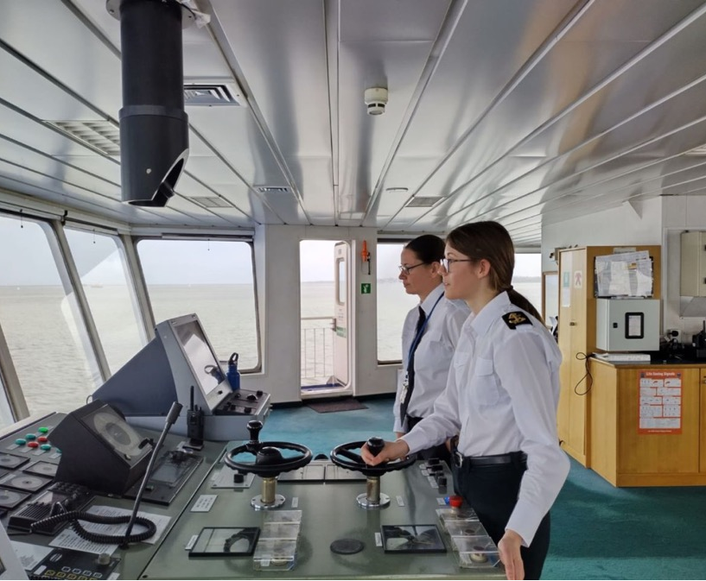
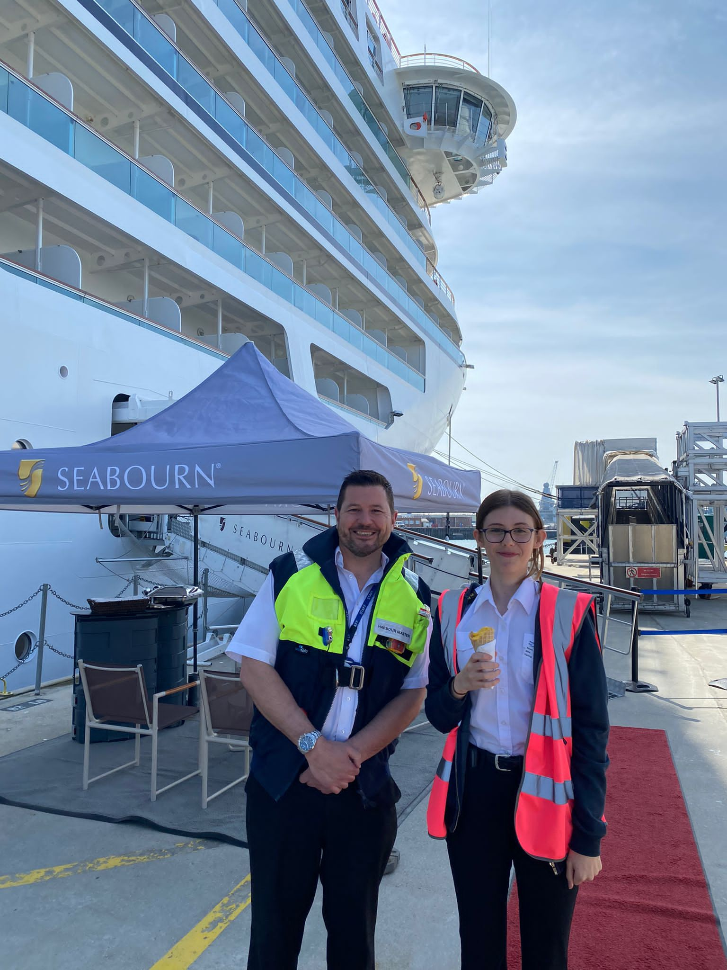
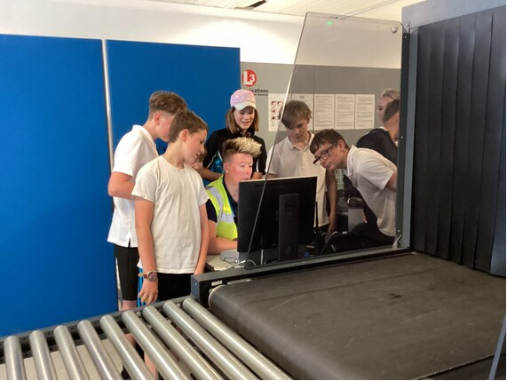
A huge Thankyou to Portsmouth International Port for allowing Brockenhurst College pre Cadet Samantha Thomas to spend the week with you all , gaining invaluable insight into the day to day running of a Major Port .
From visiting Cruise Ships , Tankers , Fire Safety , Security to actually driving the Wightlink | Isle of Wight Ferries for a few miles to the Isle of Wight and much much more !
Careers Engagement
Offer free school visits
Welcome schools with SEND students
Offer placements – both short term and long term
Myself and Louis’ Dad just wanted to thank you and your staff, especially Helen for allowing him to carry out his work experience at Portsmouth International Port from 22nd to 26th May, he had a really good week and found it informative and enjoyable. Louis particularly enjoyed going on the Mein Schiff 3 on Friday and speaking to the Staff Captain, Pilot, Port Director and the forthcoming Lord Mayor. The whole experience has definitely made him decide that he wishes to pursue a career in the Merchant Navy.

