Slide 1
Challenges with new innovative solutions in ports
Chris Hatter

Slide 2
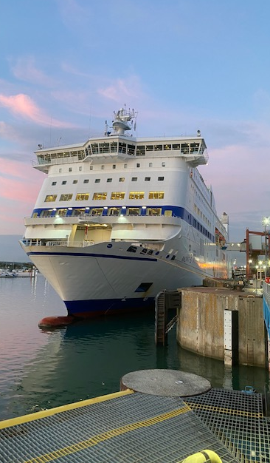
INTRODUCTION:
Port industry is undergoing rapid change:
Digitalisation
Automation
AI
Data manipulation
Why:
Continuous Improvement
Cost saving
Employment challenges
Better support for customers and port users
ALSO INDUCEMENT FROM GOVERNMENT TO DO SO!

Slide 3
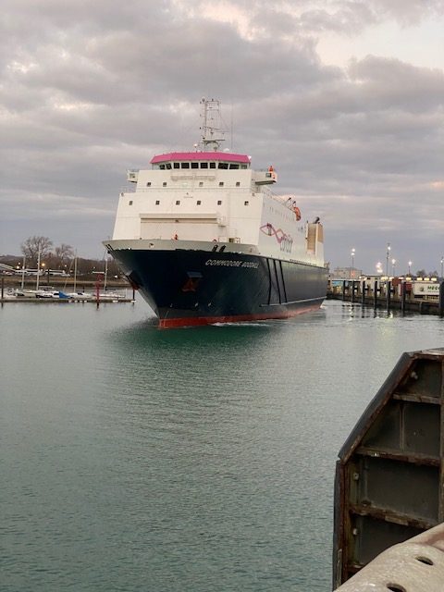
Portsmouth's place:
Like other ports we're part of multiple innovation schemes.
We have had some big successes with these schemes.
But it has not been plain sailing. Huge pressure on our workforce and some projects are seeing delays.
Thought it would be useful to share some of the challenges we are seeing and highlight how skills in the QHSE area can be applied.

Slide 4
Business/resource factors:
Is there sufficient resource to make the trial work?
Is the scope properly defined?
What competing projects are in the pipeline?
Is this a business need or want?
What do you want from the project and have you thought of the next step?
Can you take a trial into contract and when do you internally discuss this?
Will there be value for money?
What other uses may come out of the development?

Slide 5
Legal issues:​
​
Will the product be legal?​
What legislation/regulation and controls are in place for this?​
Can you insure against the innovation risks?​
Will there be warranty issues with machinery/equipment?​
What competency requirements are needed?​
Are suitable risk assessments and controls in place?​
What is the business appetite for risk?​
Will this affect other users/stakeholders?
Will there be security risks?
​

Slide 6
Data and IT issues:
What systems will this product interact with?
What data will be used and how?
Are DPIAs (Data Protection Impact Assessments) in place?
Will new hardware be required?
Do you have the right to share the data and do your policies allow this?
Will the system work with your current systems?
Are there business resilience risks?
Will you need to train parts of your organisation in new skills?
How much do you outsource, do you know where and who will have access?

Slide 7
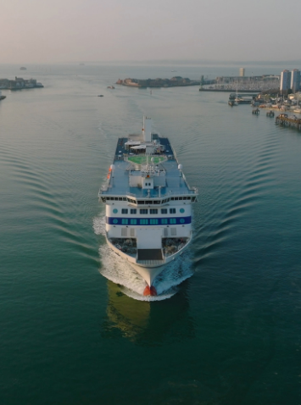
People issues:
How will you deal with resistance to change?
Will there be internal competition for resource (other projects)?
How will you deal with blockers?
How will you train out the new innovation both in development and operation?
Have you considered the cost of trials?
What is the reputation risk?
Have you got buy in from staff, management, third parties?
Are there risks to you? - credibility? Reputation?

Slide 8
What can we do?
Plan – Do – Check – Act
Ensure resource in place
Use tools such as Kotter Framework
Engage early and build a risk register
Build that coalition and find champions

Slide 9
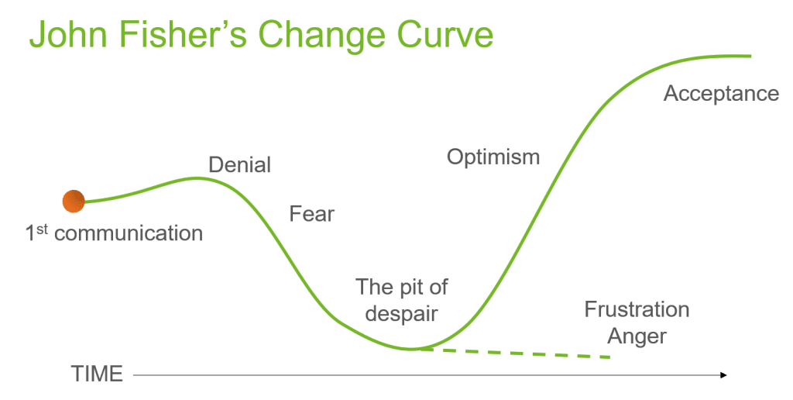
What can we do?
Be ready for despair!
Be resilient
Have check points and know when you are off track
Find multidiscipline supporters when you hit the hurdles
Communicate your challenges
Make sure you don't rush out a poor product

Slide 10
Thank you
Any questions?

